Slide 1
109 Data Structure the 4th Homework

Slide 2
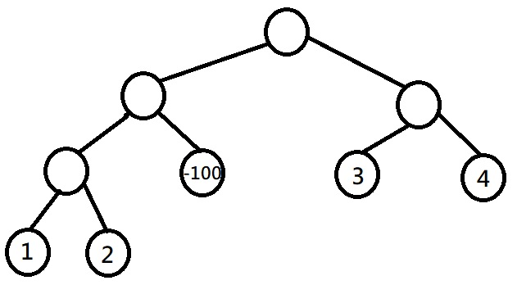
Hint for HW3, Q1-1
Array = [1, 2, -100, 3, 4]
P 1 5
P 1 3
P 1 2
P 2 3

Slide 3
Hint for HW3, Q1-1
Array = [1, 2, -100, 3, 4]
M 2 X

Slide 4
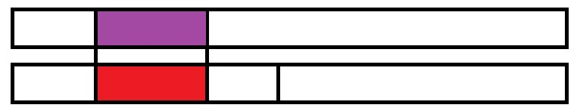
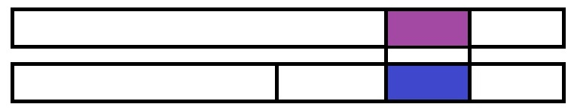

Hint for HW3, Q1-1
4 value:
ans
left
right
all

Slide 5

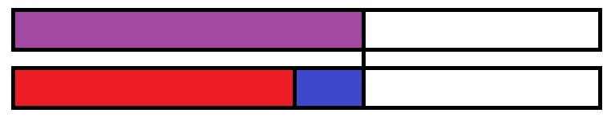
Hint for HW3, Q1-1
Update left

Slide 6
Symbolic Equations (20%)
Symbolic equation is a mathematical equation declaring the equivalence of a group of operations.
You need to print the general solutions to a symbolic system. The general solutions are ones which cannot be simplified.
If any of the equations contain circular reference or self reference, the answer shall be “no solution”.

Slide 7
Symbolic Equations (20%)
Input:
Line 1: An integer N indicates the number of variables.
Line 2: N space-separated variables.
Line 3: An integer M represents the number of equations.
Next M lines: An equation in the format of variable = function.
Note: If a variable is not declared, the solution for the variable is itself.
Output:
N lines: A solution for each variable. The solution should be formatted as variable -> solution.
Or
Line 1: No solution.

Slide 8
Symbolic Equations (20%)
For example:
3 (N)
x y z
2 (M)
z = f ( x y )
y = h ( x )
output:
x -> x
y -> h ( x )
z -> f ( x h ( x ) )

Slide 9
Symbolic Equations (20%)
For example (circular reference):
2 (N)
x y
2 (M)
x = f ( y )
y = f ( x )
output:
No solution.

Slide 10
Symbolic Equations (20%)
For example (self reference):
3 (N)
x y z
2 (M)
x = f ( x )
y = g ( y z )
output:
No solution.

Slide 11
Symbolic Equations (20%)
For this problem:
The number of variables is N.
1 ≤ N ≤ 10
The number of equations is M.
0 ≤ M ≤ 10
1 ≤ the length of each variable name ≤ 2
1 ≤ the length of each function name ≤ 2
Time Limit: 2 seconds.

Slide 12
A Sticky Safe Lock (20%)
There is a locked safe in front of you. You know the 4-digit password of its password lock.
Unfortunately, the password lock on it is sticky. When you rotate one of the dials, the dials next to it will also be turned.
Moreover, there are a note and a set of forbidden password on the lock: “If you rotate the dials casually, the safe will explode.”
You decide to write a program to solve this problem.

Slide 13
A Sticky Safe Lock (20%)
Input:
Line 1: 4 integers indicate the digits on the password lock now, separated with space.
Line 2: 4 integers represent the password, separated with space.
Line 3: An integer N.
Next N lines: The forbidden password.
The sequence of your steps should not contain the password in the set.
Output:
Line 1: An integer M indicates the shortest step.
Next M lines: The sequence of the steps.
Or
Line 1: “Impossible” if the explosion can’t be avoided.

Slide 14
A Sticky Safe Lock (20%)
For example:
0 0 0 0
0 0 0 1
2 (N)
1 1 0 0
0 0 1 1
Output:
3 (M)
9990
0090
0001

Slide 15
A Sticky Safe Lock (20%)
For this problem:
There are 4 digits on the lock.
The digits of the password can be [0..9]. 0 is after 9, and 9 is before 0.
The number of the forbidden password is N.
0 ≤ N ≤ 9999
Time Limit: 2 seconds.

Slide 16
Haunted Mansion(30%)
There’s a haunted mansion. Your scouts report you the message of the mansion. You need to figure out the information about the monsters.
However, there are mirrors in the mansion. Moreover, each kind of the monsters has a different property about the mirrors.
You need to consider both of the mirrors and the properties of the monsters, then find out the most reasonable information.

Slide 17
Haunted Mansion(30%)
Input:
Line 1: 3 Integers Vcount, Zcount, Gcount indicate the number of each type of monster in the grid.
Line 2: An integer N indicates the size of the manor.
Next 4 lines: N integers represent the number of visible monsters from
top of the grid, from left to right.
bottom of the grid, from left to right.
left of the grid, from top to bottom.
right of the grid, from top to bottom.
Next N lines: N characters. ‘.’ indicates a monster in the grid, and ‘/’, ‘\’ indicate a mirror in the grid.

Slide 18
Haunted Mansion(30%)
Output:
N lines: N characters.
The lines represent the whole manor.
The character will be
V for a vampire
Z for a zombie
G for a ghost
/ or \ for a mirror.
You can’t see a vampire through a mirror.
You can see a zombie directly or through a mirror.
You can see a ghost ONLY through a mirror.

Slide 19
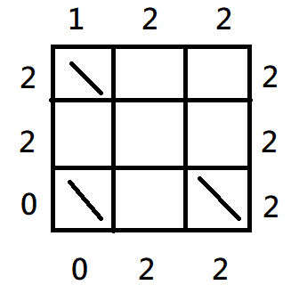
Haunted Mansion(30%)
For example:
Input:
1 3 2 // Vcount, Zcount, Gcount
3 (N)
1 2 2
0 2 2
2 2 0
2 2 2
\..
...
\.\

Slide 20
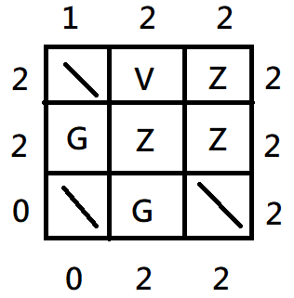
Haunted Mansion(30%)
For example:
1 3 2 (Vcount, Zcount, Gcount)
Output:
\VZ
GZZ
\G\

Slide 21
Haunted Mansion(30%)
For this problem:
The size of the manor is N.
0 ≤ N ≤ 7
0 ≤ Vcount ≤ N
0 ≤ Zcount ≤ N
0 ≤ Gcount ≤ N
Time Limit: 2 seconds.

Slide 22
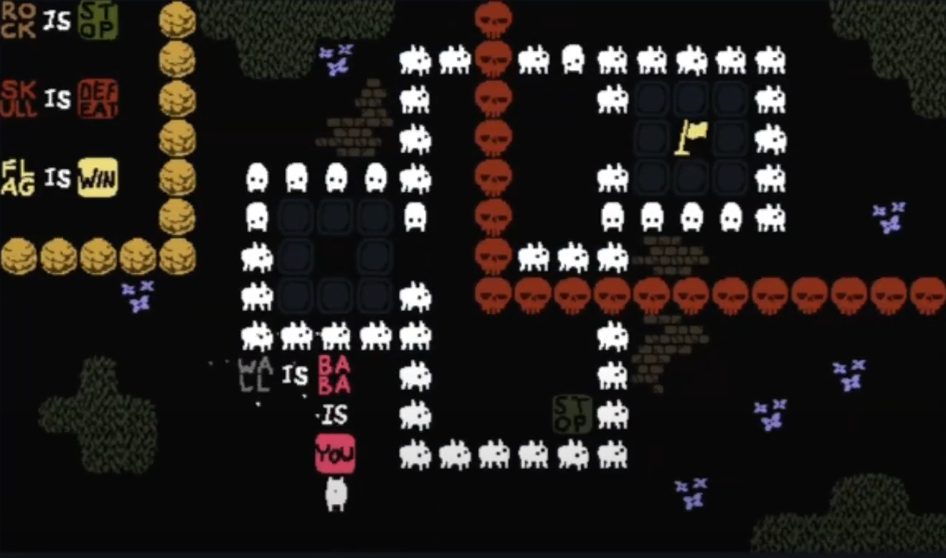
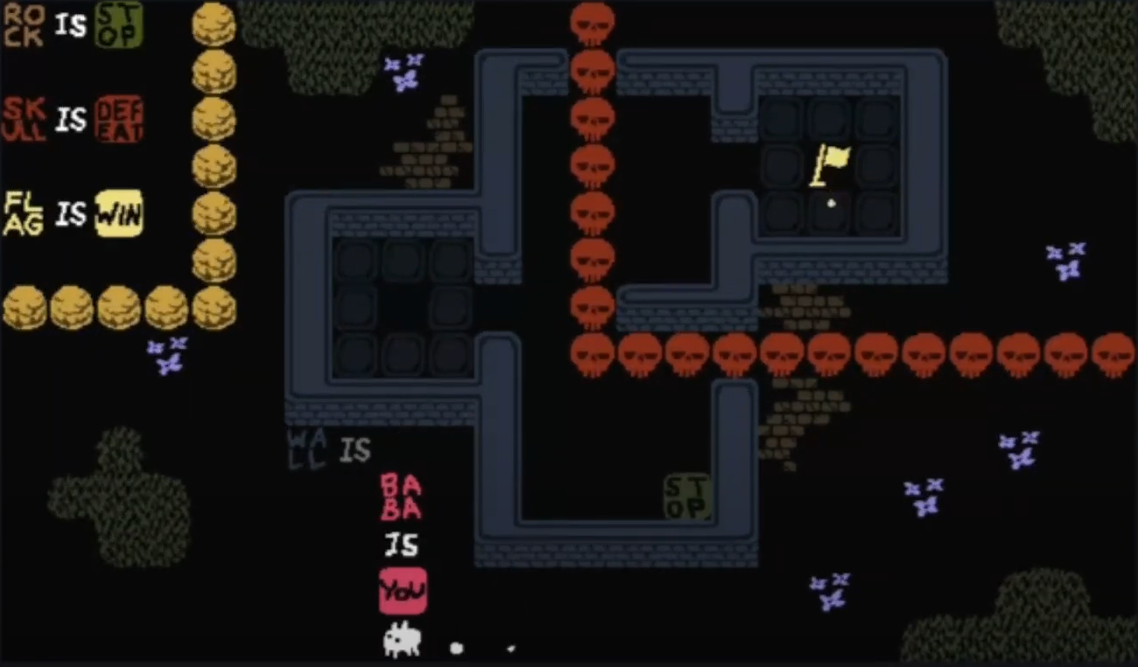
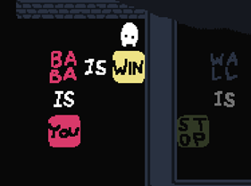

Baba is You(30%)
Independent Game Festival (IGF) is an annual event. The game “Baba is you” won the 2018 “Excellence in Design” and “Best Student Game” Awards.
In the game, the logic is according to a block connected to the other block.
You control things that “IS YOU”.
The only goal of the game is let “YOU” reach “WIN”.

Slide 23
Baba is You(30%)
In this puzzle, I’ll give you a set of universal truths, you need to determine whether
All pigs can fly.
Some pigs can fly.
No pigs can fly.

Slide 24
Baba is You(30%)
Each of the input sentences contains a logical statement in the general form:
ObjectA (are ObjectB | have Trait | can Ability)
or TraitA are TraitB
Furthermore, objects can be expanded to:
Object [with TraitA [and TraitB ...]] [that can AbilityA [and AbilityB ...]]
MICE are RODENTS
MICE have WINGS
MICE that can FLY are ANIMALS with SUPERPOWERS

Slide 25
Baba is You(30%)
For example:
1)MICE are RODENTS
2)MICE with WINGS are BATS
3)MICE that can FLY are ANIMALS with SUPERPOWERS
4)BATS are RODENTS
5)RODENTS with FEET and NOSES that can EAT are POPSICLES
To clarify, statement 1 means that all MICE are RODENTS, but only some RODENTS are MICE.
It cannot be assumed from statement 1 and 4 that some MICE are BATS.

Slide 26
Baba is You(30%)
The other examples:
1) CHICKENS with BEAKS are LLAMAS with MOUTHS
2) CHICKENS have BEAKS
Some LLAMAS with MOUTHS have BEAKS.
All CHICKENS are LLAMAS with MOUTHS.
1) CHICKENS with BEAKS are LLAMAS with MOUTHS
2) CHICKENS have BEAKS and EYES
Some LLAMAS with MOUTHS have EYES (and BEAKS).
All CHICKENS are LLAMAS with MOUTHS.

Slide 27
Baba is You(30%)
For all the inputs, print “No/Some/All pigs can fly.” (30%)
Line 1: An integer N represents the number of logical statements.
Next N lines: A logical statement.
output: “All/Some/No pigs can fly.”

Slide 28
Baba is You(30%)
For example (green sentences are results):
3
PIGS are BACONS
BACONS are GODS
(Thus, All PIGS are GODS)
GODS can FLY
output: All pigs can fly

Slide 29
Baba is You(30%)
7
GEESE are CHICKENS with BEAKS
BEAKS are TOENAILS
CHICKENS with BEAKS are LLAMAS with MOUTHS
CHICKENS have EYES
(All GEESE are LLAMAS with MOUTHS and EYES and TOENAILS and BEAKS)
CHICKENS with EYES and TOENAILS are TREES that can FLY
(All GEESE are CHICKENS with EYES and TOENAILS)
→ (All GEESE are TREES that can FLY)
LLAMAS with TOENAILS are PIGS
PIGS are TREES that can WALK
(All GEESE are PIGS, All GEESE are TREES that can FLY)
(Some PIGS are GEESE)
output: Some pigs can fly

Slide 30
Baba is You(30%)
For this problem:
The number of the statements is N.
2 ≤ N ≤ 15
The length of the a statement is L.
1 ≤ L ≤ 256
“PIGS” exists in 1 or more statements for sure.
“FLY” exists in 1 or more statements for sure.
Object, Trait, Ability are written in uppercase, and everything else is in lowercase.
Time Limit: 2 seconds.

Slide 31
Reminders
For all of the question, please read test.txt as input and output in the terminal window.
對於所有問題，請都讀test.txt作為input，然後輸出在小黑窗上
If you can, please let me know how to change your I/O file name so that I can modify the path from test.txt to test1.txt, test2.txt, etc.
假如可以的話，讓我清楚知道從哪裡更改你I/O檔案的名稱，方便我可以從讀test.txt改成讀test1.txt, test2.txt，會改得比較快。
如果我看不懂，那我不會改你的code，一律讀test.txt。

Slide 32
Reminders
Only accept C
Deadline : 2020/12/21 23:59, please be on time.
File name : [student ID]_[question No.(1..4)].[file name extension]
e.g. 7109056193_1-1.c
If there are more than 1 file for 1 question, please give a readme.txt for me and let me know the meaning of each file.
No need to give me the output, I’ll execute your program.
Zip all your files and hand in on the i-learning, the file name is [student ID]_homework4.
Plagiarism is prohibited.
Dev-C++ 5.11 is used for checking this homework.

